Slide 1
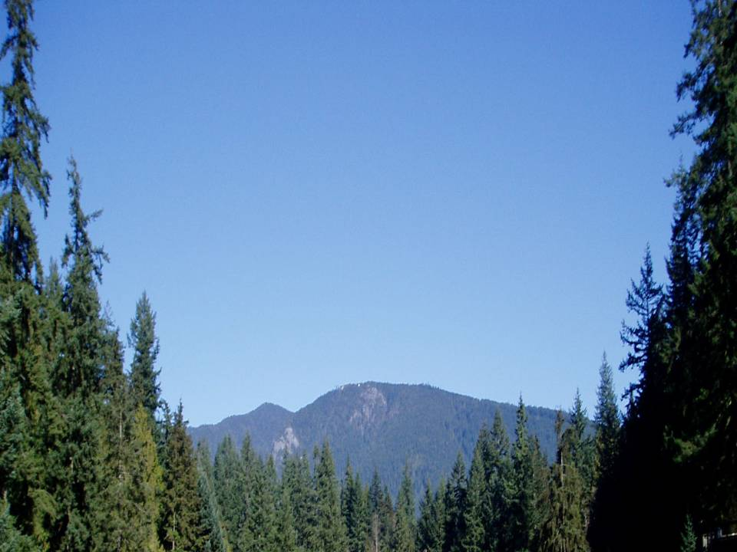




Mapping of stress on native tree species across western U.S.A. & Canada: interpretation of climatically-induced changes using a physiologically-based approach
Richard Waring¹
Nicholas Coops²
Amanda Mathys ²
Thomas Hilker¹
Wendy Peterman³
¹ Oregon State University
² University of British Columbia
³Conservation Biology Institute
I R S S

Slide 2
Major Points
importance of mapping soil H₂0 storage
Spatially linked max leaf area to productivity
value of sharing data with the public

Slide 3
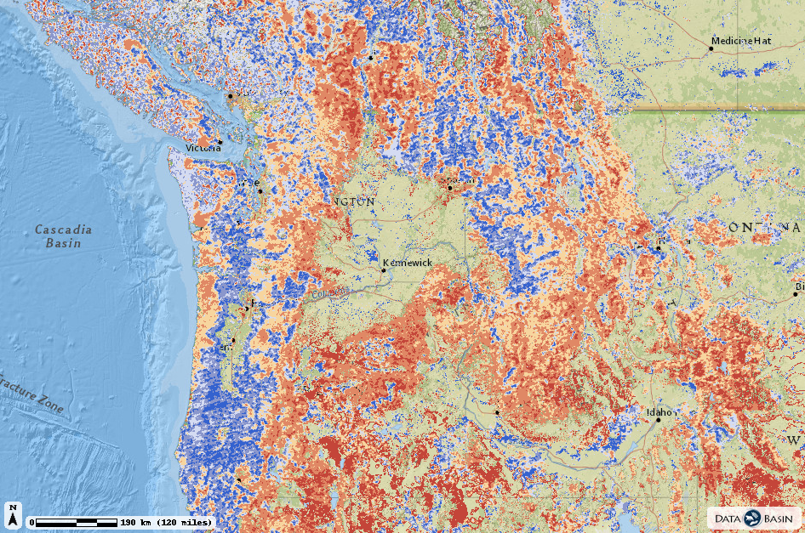
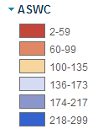
Base map of modeled estimates of available soil water storage capacity (mm)
Coops, Waring, & Hilker (2012) Predicting soil properties using a process-based forest growth model to derive estimates of leaf area index. Remote Sensing of Env. 126:160-173.
http://databasin.org/maps/new#datasets=9c19fc0df04c43aea41983fcfce358c0

Slide 4
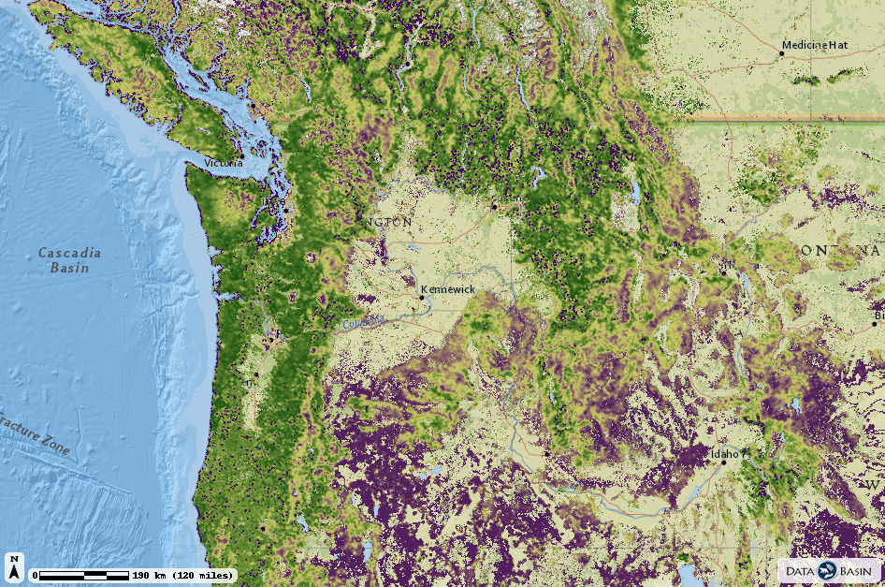

Base map of modeled estimates of soil fertility at 1 km resolution
(0 = poorest; 1.0 = best)
Coops, Waring, & Hilker (2012) Predicting soil properties using a process-based forest growth
model to derive estimates of leaf area index. Remote Sensing of Env. 126:160-173.
http://databasin.org/maps/new#datasets=9c19fc0df04c43aea41983fcfce358c0

Slide 5
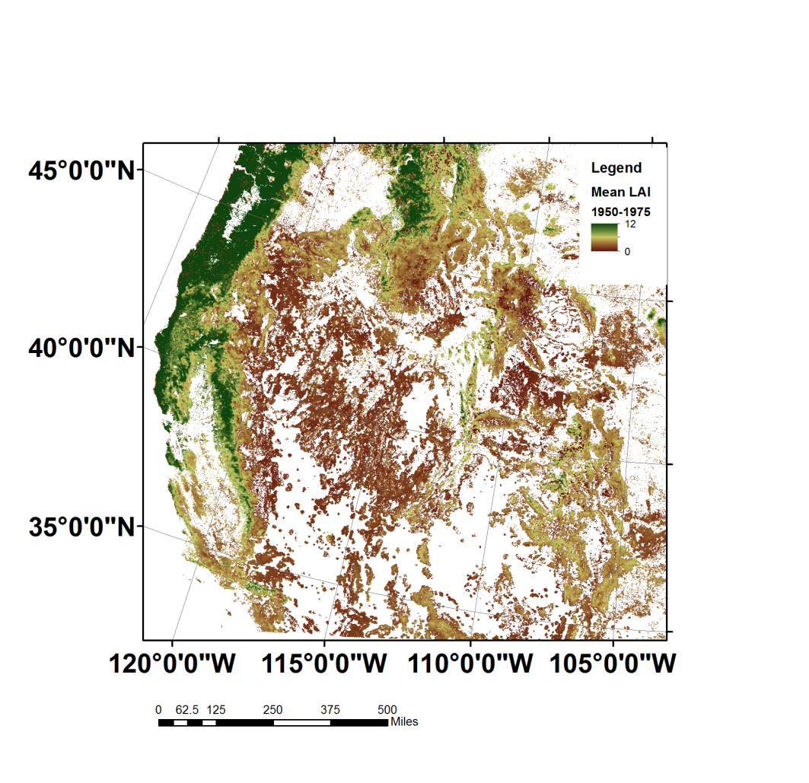
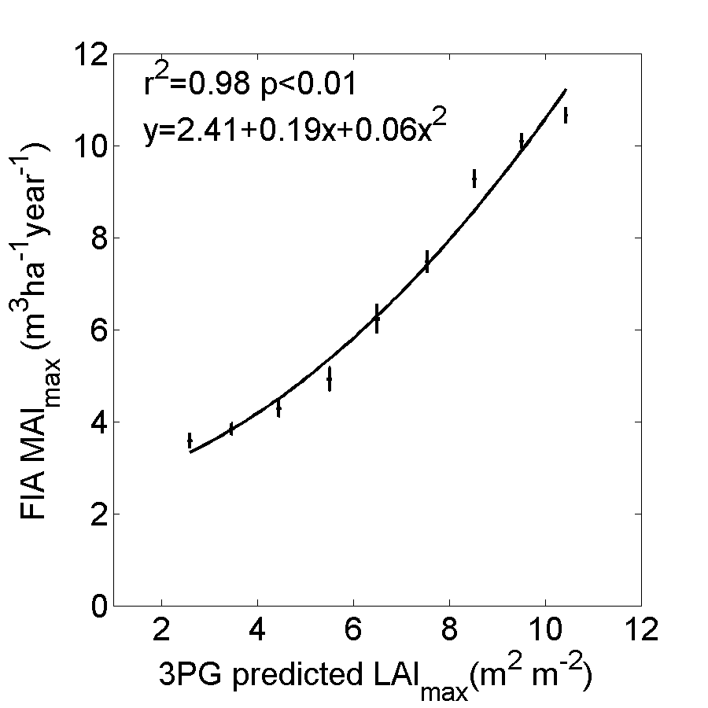
Relation between modeled
max LAI & site productivity
(3,356 field plots)
Simulated max LAI
(2000-2009 climate)
Waring, Coops, Mathys, Hilker & Latta (2014) Process-based modeling to assess
the effects of recent climatic variation on site productivity and forest function
across western North America. Forests 5:518-534.

Slide 6
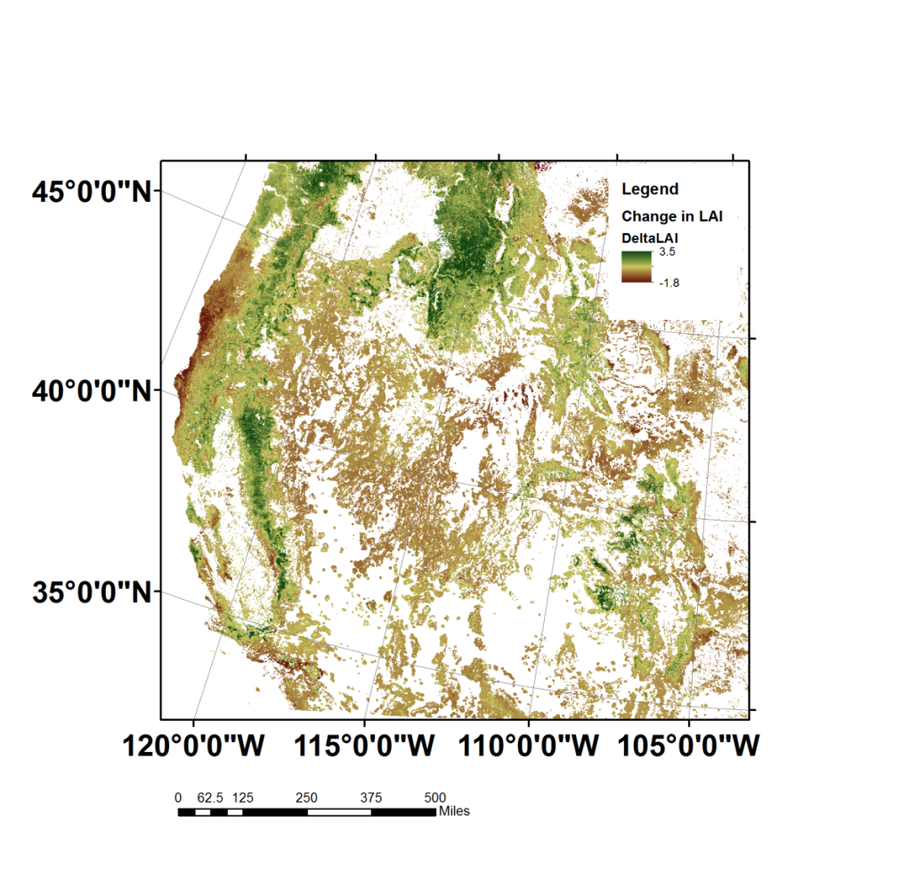
Simulated change in maximum leaf area index
2000-2009 in reference to 1950-1975 climate
Waring, Coops, Mathys, Hilker & Latta (2014) Process-based modeling to assess the effects of recent climatic variation on site productivity and forest function across western North America. Forests 5:518-534.

Slide 7
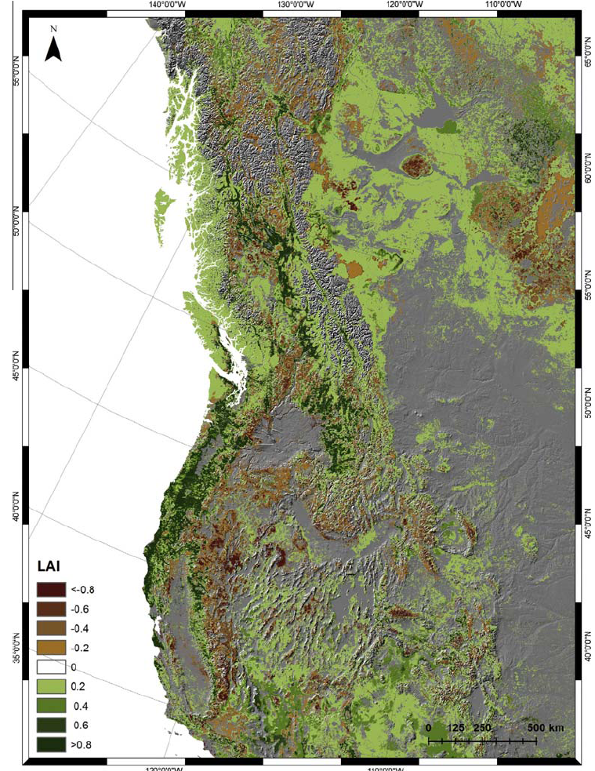
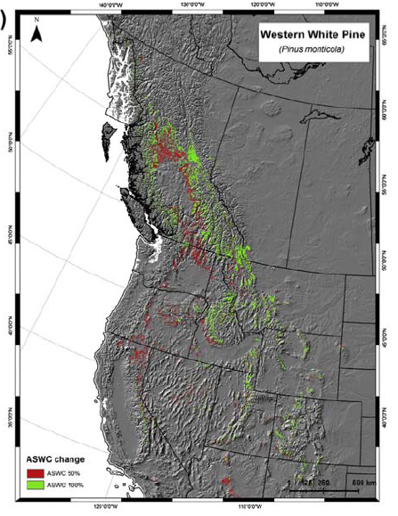
Effect on max LAI when
soil H₂0 storage = 200 mm
Effect on predicted range when
soil H₂0 storage changed ± 50%
Mathys, A., N.C. Coops & R.H. Waring. 2014. Soil water availability effects on the
distribution of 20 tree species in western North America. For. Eco. & Mgmt. 313:144-152.

Slide 8
Project shares all data via Conservation Biology Institute’s website: databasin.org
remote sensing products
model code in C++
soils mapping units
species present at 44,000 field sites
simulated shifts in range of 20 species
publications

Slide 9
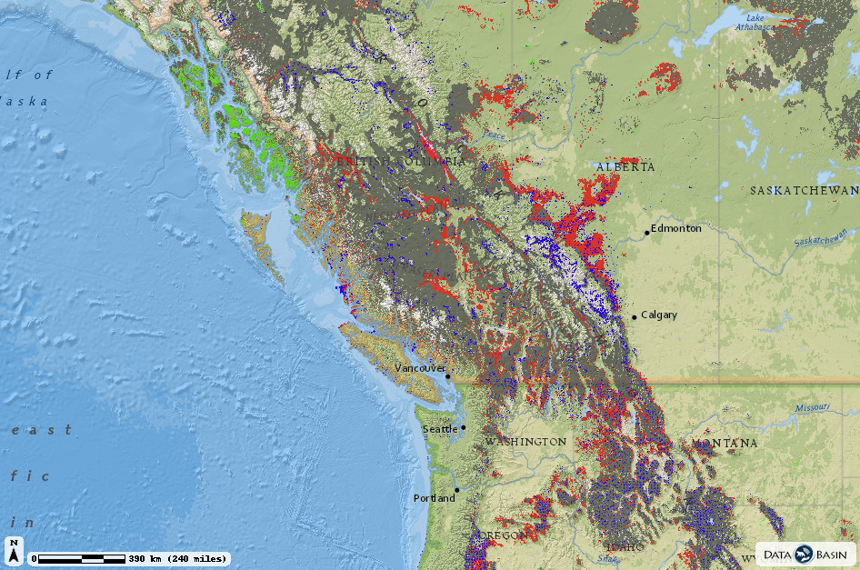

Lodgepole pine: Predicted potential shift in range since 2000
Tree species plots
http://databasin.org/maps/b2905dd782374dfd81d51fae6b16fcd4

Slide 10
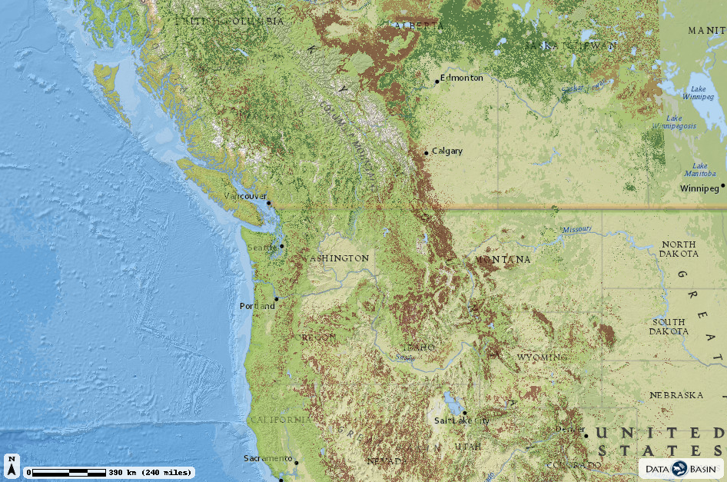
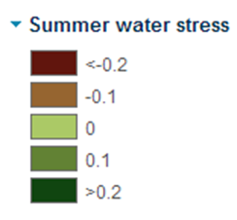
Relative change in summer soil water constraints (± 20%)
contrasting climate conditions since 2000 with 1950-75 period
http://databasin.org/maps/dcd8043a7ed44581adae3555fe0f6db8/active

Slide 11
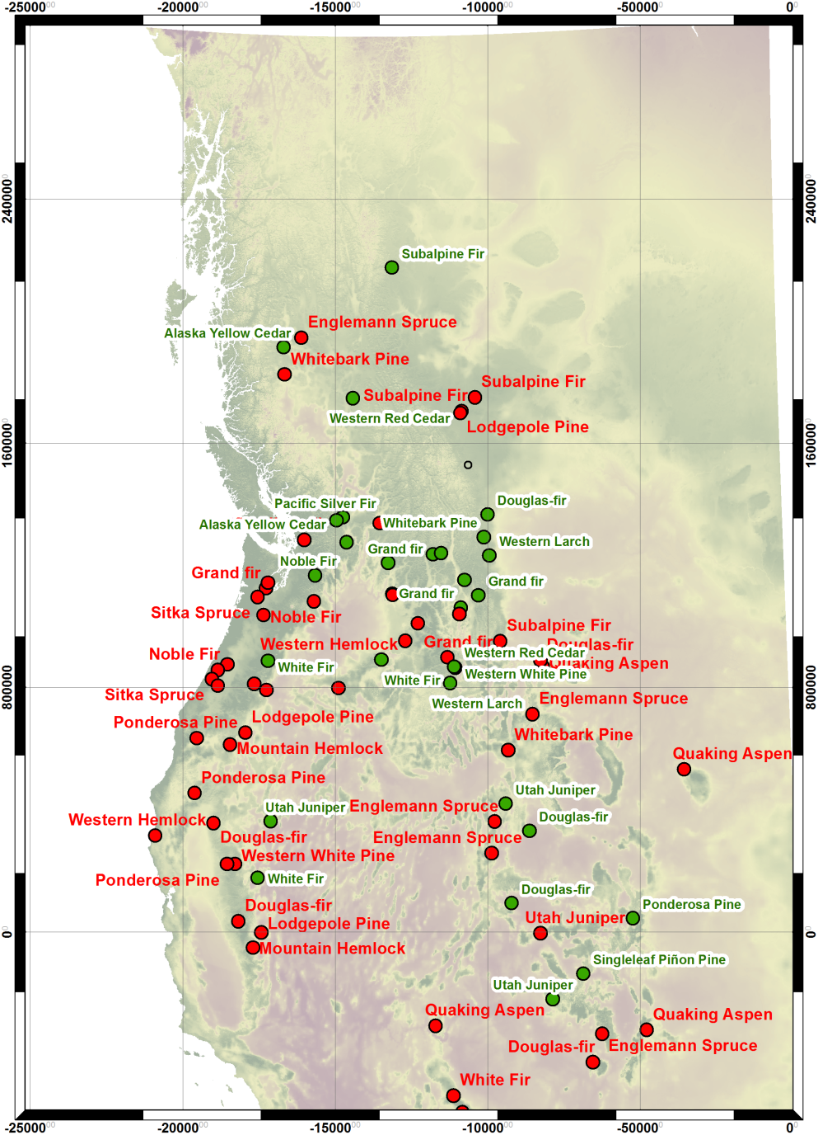
80 sites where twenty tree species are predicted to have
the potential to contract (red) or expand (green) their range
since 2000

Slide 12
Project Publications 2011-2014
Waring, R.H., Coops, N.C., Mathys, A., Hilker, T. and Latta, G. 2014. Process-based modeling to assess the effects of recent climatic variation on site productivity and forest function across western North America. Forests 5:518-534.pdf
Mathys, A., Coops, N.C., and Waring, R.H. 2014. Soil water availability effects on the distribution of 20 tree species in western North America. Forest Ecology and Management 313: 144-152. pdf.
Smettem, K.R.J., R.H. Waring, N. Callow, M. Wilson, and Q. Mu. 2013. Satellite-derived estimates of forest leaf area index in South-west Western Australia are not tightly coupled to inter-annual variation in rainfall: implications for groundwater decline in a drying climate. Global Change Biology 19:2401-2412. (pdf).
Coops, N.C., R.H. Waring, and T. Hilker. 2012. Prediction of soil properties using a process-based forest growth model to match satellite-derived estimates of leaf area index. Remote Sensing of Environment 126:160-173.pdf.
Peterman, W., R.H. Waring, T. Seager, and W.L. Pollock. 2012. Soil properties affect pinyon pine-juniper response to drought. Ecohydrology 6:455-463.pdf.
Coops, N.C., M.A. Wulden, and R.H. Waring. 2012. Modeling lodgepole and jack pine vulnerability to mountain pine beetle expansion into the Canadian boreal forest. Forest Ecology and Management 274:161-171. pdf.
Waring, R.H., N.C. Coops and S.W. Running. 2011. Predicting satellite-derived patterns of large-scale disturbances in forests of the Pacific Northwest Region in response to recent climatic variation. Remote Sensing of Environment 115:3554-3566.pdf.

Slide 13
Contact Information
Waring, Richard <richard.waring@oregonstate.edu>
http://www.fsl.orst.edu/~waring
Coops, Nicholas
<nicholas.coops@ubc.ca>
Project website:
http://www.pnwspecieschange.info/

